Slide 1
Integrated Services Detailed Overview

Slide 2
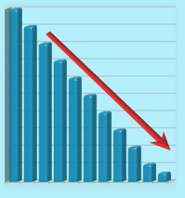
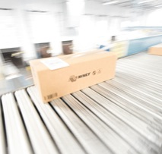
Why Outsource Integration?
Costs
Reduced expenses
Expanded markets
Time to market
Customer satisfaction
Competitiveness

Slide 3
Improve Efficiencies While Minimizing Costs
Shift spending from business-as-usual to new capabilities and greater flexibility
Capacity Limitations
Rising in-house integration fixed costs
Hassle of technical certifications
Supply chain operational inefficiencies
Common Customer Challenges
Rising shipping / logistics management costs
Quality management certification issues
Availability and utilization of in-house technical staff
Coordinating cross vendor technical capabilities

Slide 4
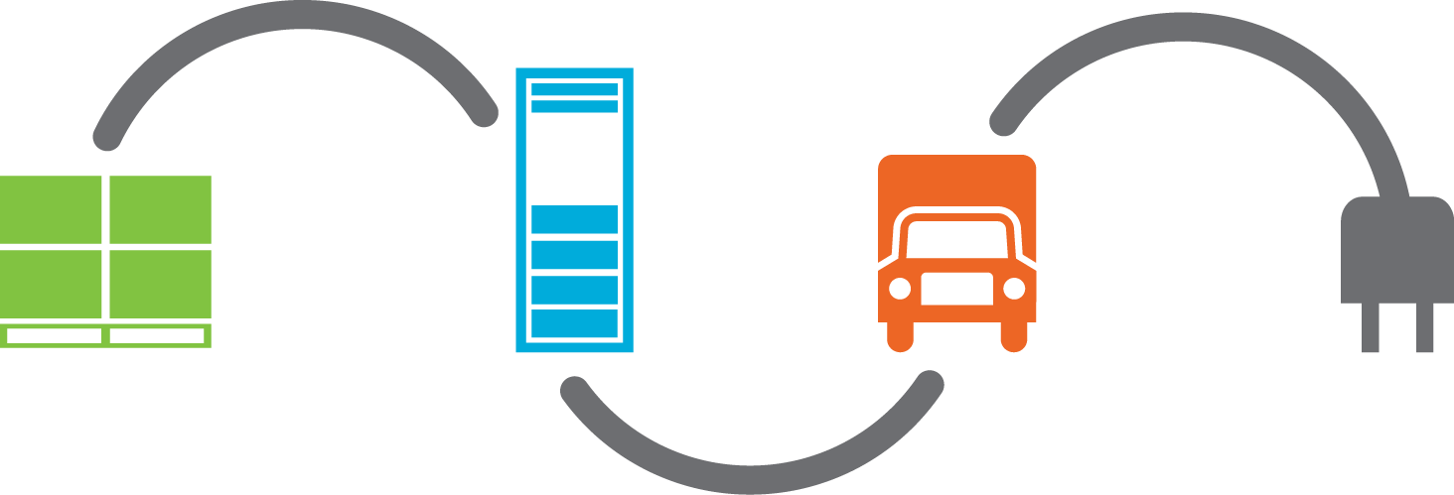
Deliver Solutions Faster
To this
To there
From this
Then plug it in

Slide 5
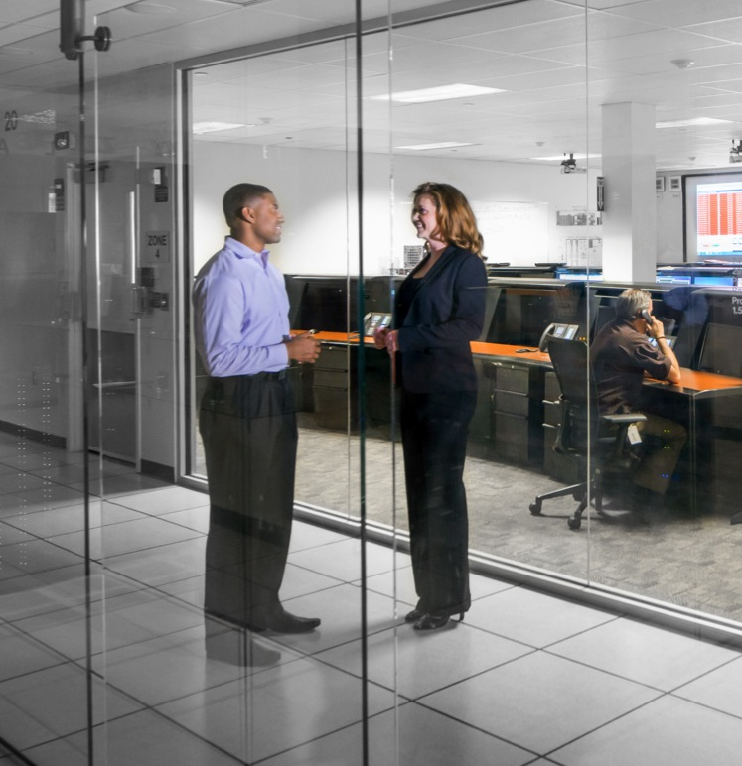
Significant Upside Potential To Your Business
Reduce costs
Variable expenses
Enhanced offerings
Expanded markets
Increased competitiveness
Greater customer satisfaction
Faster time to market

Slide 6
Global Integration Centers
Tech Data’s state-of-the-art global integration centers provide the most advanced integration and logistics capabilities possible to support your current and future business. By leveraging our advanced solution integration and delivery capabilities, you'll also add value to your solutions and increase your customer satisfaction.

Slide 7
Avnet Logistics & Integration Facilities
Global Integration Facts
World-class value-add integration
Engineering / first article dedicated lab space
Hardware and software configuration
Custom packaging and logistics solutions
Quality control support onsite
ISO certified
Repair depot lab
ESD protected floors and smocks
Technology and customer specific production lines
Custom branding
Differentiators
Design anywhere / build anywhere
Consistent process globally among Avnet facilities
Global repair and refurbishment capabilities onsite
Lean initiatives, including Kaizen principles
5S visual factories
Industry leading technical professionals
Global standardized production methodology
Export compliance
Freight cost optimization
Customer specific labeling and packing
Reverse logistics (RMA)

Slide 8
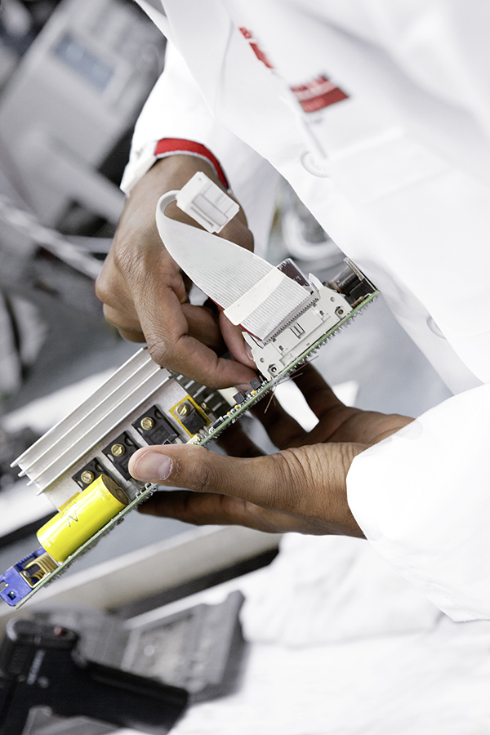
Service Offerings: Repair Depot Lab
Basic Services
1 year to return to depot on OEM product
Maintain to ECN/ECO specifications
Alternate manufacturing site cleanup
Custom / Premium Orders
365-day factory repair offering
Advanced Services
OEM spares program
Retrofit/refurbishment program
Warranty/non-warranty repair
Recovery CD/DVD capabilities

Slide 9
Service Offerings: Software Configurations
Basic Services
Using best practices for installation of operating systems
Standard diagnostics and/or custom functional testing
BIOS and firmware updates
Custom / Premium Orders
Operating system customization
Loading customer site-specific data
Proprietary customer application loads
Advanced Services
Operating system installation (Microsoft, Linux, AIX, UNIX, QNX, VMWare)
Custom image loads, VPN access
Application loading, configuration and testing

Slide 10
Service Offerings: Operations and Performance Integration
Hardware
Software
Converged
Application Load
Multi-Vendor Equipment
Motherboard
Memory
Linux
Processor
SQL Scripting
Solution Integration
Volume
VMware
HDD
Embedded
Customer Specific Requirements
Unix
Configuration & Racking
Storage
Windows
Depot Repair
Complexity

Slide 11
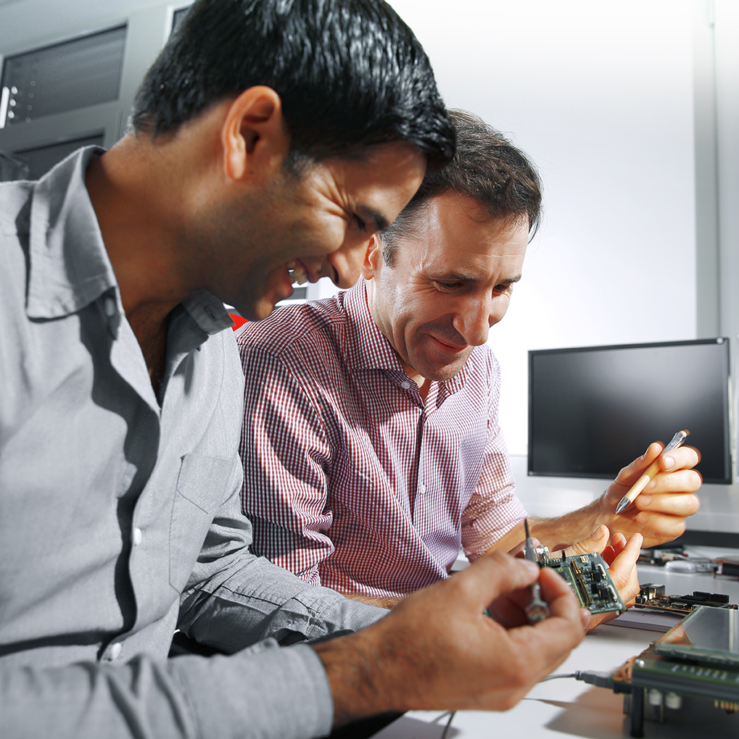
Service Offerings: Engineering
Quoting & Onboarding (Solutions Desk)
Business development
Integration onboarding
Integration & engineering
Labor & service quotes
Facility tours
RFP / RFQ services
Specifications (Enabling Services)
OSI (order specific instructions)
One-off, site-specific, variables
Deviation
Project Management (Technical Project Managers)
ECR analysis & action plans
Large ECO/ deviation execution & management
Complex order management
Engineering (Project Services)
First article
EVO/ECO sustaining services
First article lab for non-disclosure

Slide 12
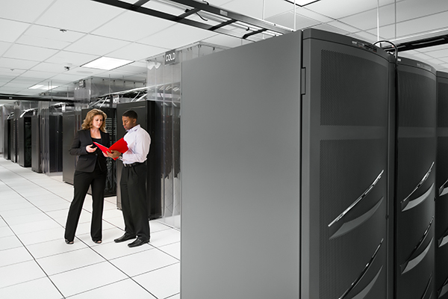
Service Offerings: Data Center
Supports both integration activities and IT Demo Central
Host customer servers for integration purposes with secure VPN access
Customer secure remote access to production systems
Provide custom storage solutions
House customer supplied images

Slide 13
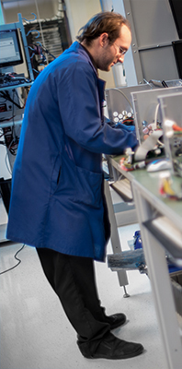
Service Offerings: Hardware Integration
Basic Services
Motherboard population
System and device testing
Mass-media drive duplication and installation
Duplication of media (CD/DVD, hard drive, compact flash, USB)
Advanced Services
Customer-owned inventory (COI) install
RAID/cluster setup
Server/workstation configuration
SAN/NAS and expansion storage builds
Custom wireless device builds (Mobility / RFID / OEM handheld device builds)
Cable management
Custom hardware integration
Comprehensive rack, stack, cable, label, power balance and document
Custom/Premium Orders
Custom cabling/racking
Custom displays/kiosks (touch screen application)
Multi-system and custom solution Integration

Slide 14
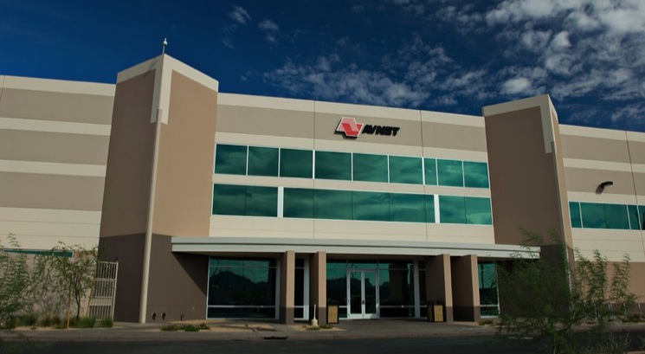
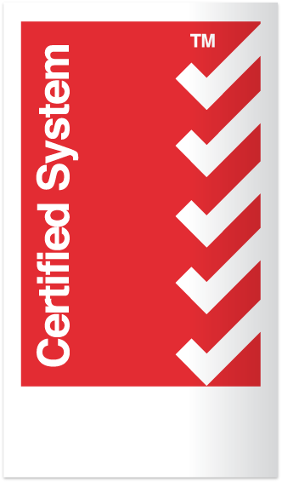
Western Solution Showcase Center, Chandler, Arizona
Full service for all solution units
Complete UPS and generator coverage
Cisco L6 site certification
Alternate manufacturing site for UL/CSA/TUV and FDA requirements
Integration & Logistics Facility | 21,182 sq. m. (228,000 sq. ft.)
Repair Depot | 279 sq. m. (3,000 sq. ft.)
Integration Space | 4,181 sq. m. (45,000 sq. ft.)
Warehousing Space | 11,334 sq. m. (122,000 sq. ft.)
First Article Lab | 279 sq. m. (3,000 sq. ft.)
Data Center | 93 sq. m. (1,000 sq. ft.)
LED Light Lab | 84 sq. m. (900 sq. ft.)
ISO 9001
ISO 13485
ISO 14001
Quality Management System
Medical Device Management System
Environmental Management System

Slide 15
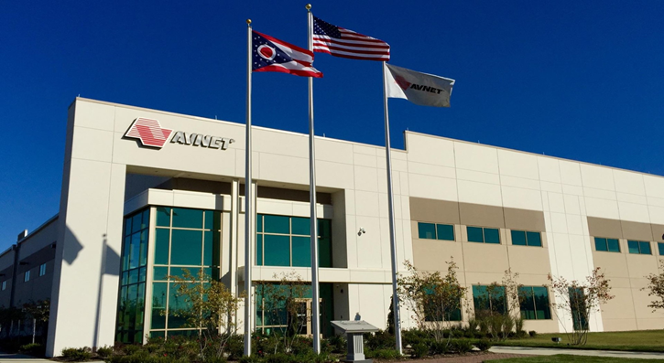
Tech Data Lifecycle Solutions, Columbus, Ohio
Collaborating with customers, partners, integrators and suppliers to maximize the potential of IT with end-to-end solutions – from procurement through integration, operations, management and disposal.
State-of-the-art, industry leading design that is both environmentally and employee friendly
Key capabilities
Product Design
Technical Assistance Center (“TAC”)
Repair & Refurbishment
Logistics and Fulfillment
Education / Training Resources
ITAD, Recycling & Remarketing
OHSAS 18001, TL9000, RIOS, R2
Integration & Logistics Facility | 53,884 sq. m. (580,000 sq. ft.)
Docks | 44
Pallet Loc. | 5,000
Additional Space for Growth | 21,089 sq. m. (227,000 sq. ft. (new building))
ISO 9001
ISO 14001
Quality Management System
Environmental Management System

